Slide 1
High-Resolution Image Synthesis with Latent Diffusion Models
Rombach, R., Blattmann, A., Lorenz, D., Esser, P., & Ommer, B.,"High-Resolution Image Synthesis with Latent Diffusion Models," in Proc. the IEEE/CVF Conference on Computer Vision and Pattern Recognition (CVPR), 2022. Available: https://arxiv.org/abs/2112.10752
2025-03-11
Sein Choi
Intelligent Vision Processing Lab. (IVPL)
https://ivpl.sookmyung.ac.kr
Div. of AI Engineering, Sookmyung Women’s University
E-mail: csi1806@sookmyung.ac.kr

Slide 2
No. | Title | Keyword | Cite
1 | Learning Transferable Visual Models From Natural Language Supervision | Contrastive Learning, Multimodal Representation | Alec Radford, Jong Wook Kim. (2021). Learning Transferable Visual Models From Natural Language Supervision, In Proc. of the 38th International Conference on Machine Learning, pages 8748–8763. PMLR. [Online]. Available: https://arxiv.org/abs/2103.00020
2 | GLIDE: Towards photorealistic image generation and editing with text-guided diffusion models | Text-to-Image Generation, Diffusion Models, guided image synthesis | A Nichol, P. Dhariwal, A. Ramesh. “GLIDE: Towards photorealistic image generation and editing with text-guided diffusion models”, In Proc. of the 39th International Conference on Machine Learning, 2022, pp. 16907-16921. Available: https://arxiv.org/abs/2112.10741
3 | Hierarchical Text-Conditional Image Generation with CLIP Latents | Text-to-Image Generation, CLIP Latents, unCLIP, Diffusion Models | Ramesh A, Dhariwal P, Nichol A, Chu C, Chen M., “Hierarchical Text-Conditional Image Generation with CLIP Latents”, 2022, Available: https://arxiv.org/abs/2112.10741
4 | High-Resolution Image Synthesis with Latent Diffusion Models | Text-to-Image Generation, VAE, Diffusion Models, Cross-Attention | Rombach, R., Blattmann, A., Lorenz, D., Esser, P., & Ommer, B.,"High-Resolution Image Synthesis with Latent Diffusion Models," in Proc. the IEEE/CVF Conference on Computer Vision and Pattern Recognition (CVPR), 2022. Available: https://arxiv.org/abs/2112.10752
5

Slide 3
Contents
Introduction
1. Perceptual Image Compression
2. Latent Diffusion Models (LDM)
+ Cross-Attention
Evaluation
Limitations & Conclusion
Code

Slide 4
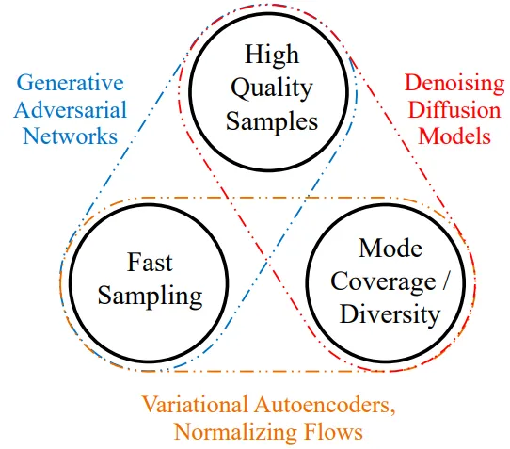
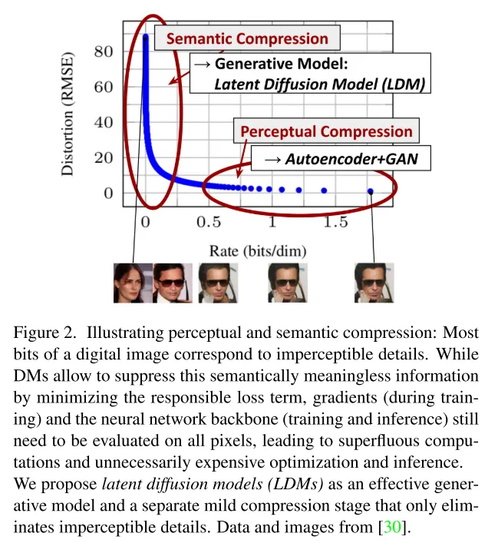
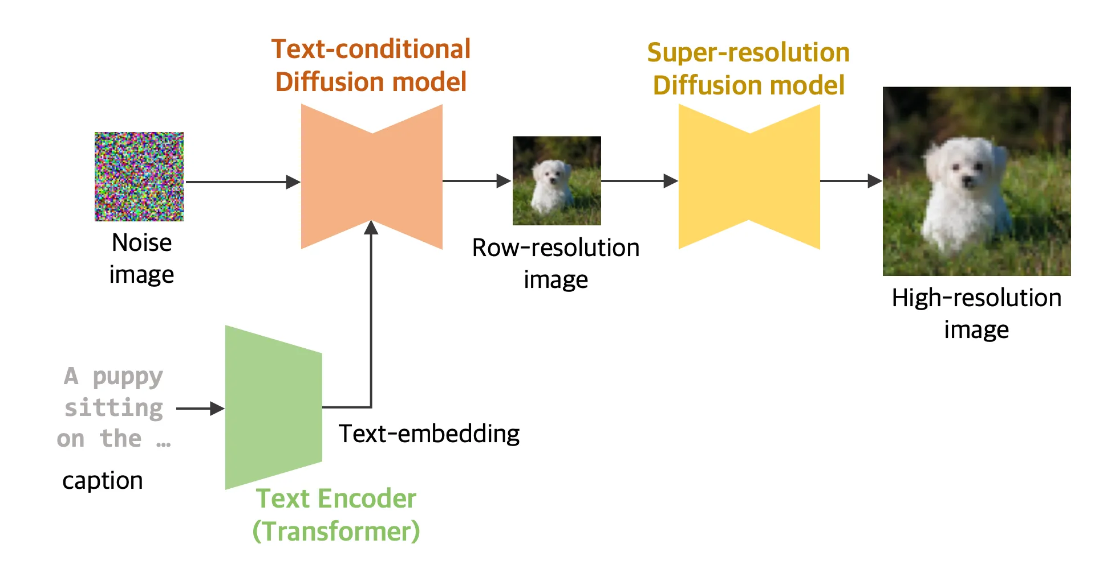
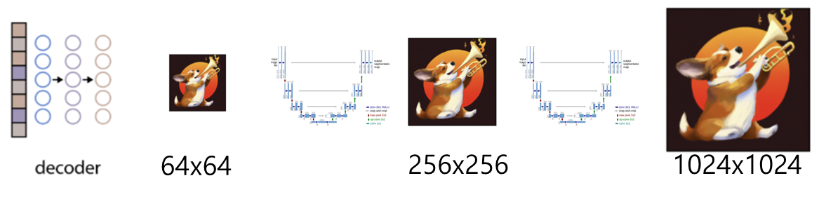
Introduction
Explicit Perceptual Compression Execution
Goal: Find a perceptually equivalent but more computationally efficient Latent Space
LDM; Latent Diffusion Models
Pixel Space
Generative learning trilemma
64x64 output
Image Generating Sequence
GLIDE
DALL-E2
Generative learning trilemma. (xiao et al., 2021)

Slide 5
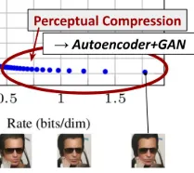
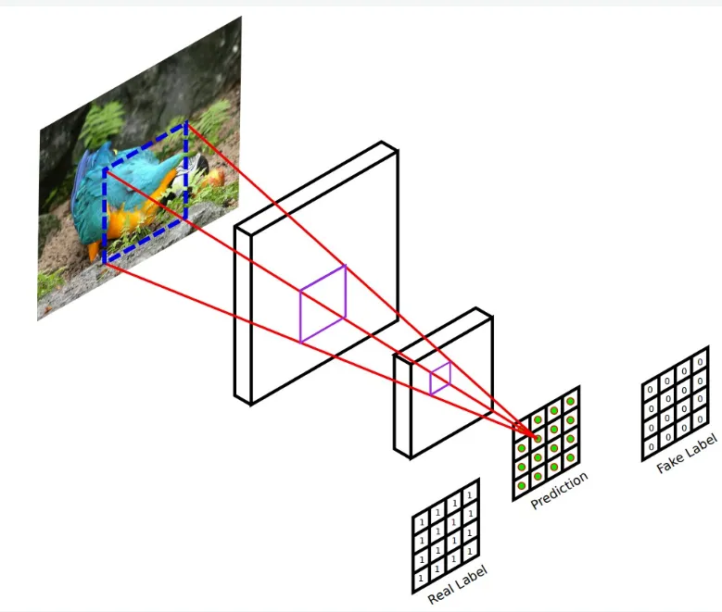
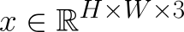
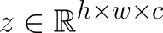
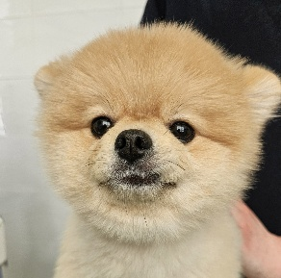
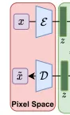
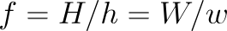
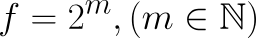
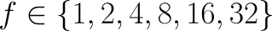
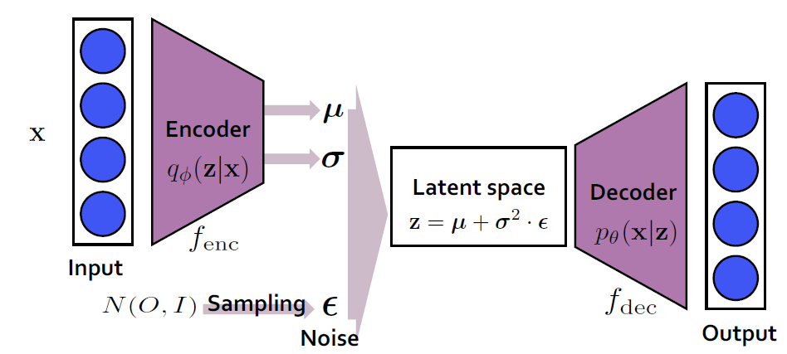
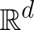
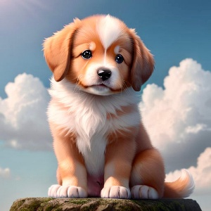
1. Perceptual Image Compression
Using Autoencoder
Remove high-frequency details that humans cannot perceive (such as texture noise and subtle pixel variations) using an autoencoder, leading to reduced computational load.
#2 loss – for perceptual compression
1. Perceptual Loss
2. Patch-based adversarial objective
#2 regularization
1. KL-reg
2. VQ-reg
❗latent space z >> 2D vector
1️⃣
Patch-based adversarial objective
Low-dimensional
Latent Space
1D
2D
Calculation Efficiency
Achieving computational efficiency while maintaining the same perceptual space as image data.
Using DM’s inductive bias
no needs for aggressive compression
Notes:
다운샘플링 팩터(f)가 8입니다. 즉, 원본 이미지 크기의 1/8로 압축됩니다. (f가 4, 8, 16, 32 있음)
차원(d)이 4입니다.

Slide 6
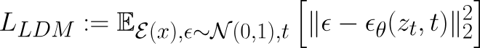
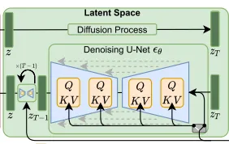
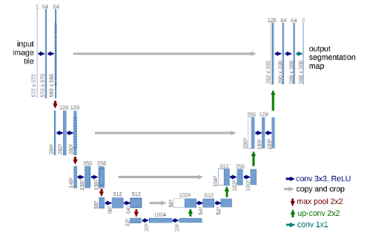
2. Latent Diffusion Models (LDM)
Using U-Net
Semaintic Compression - Learning the semantic structure (object shapes, arrangement, context) in the latent space and restoring it through denoising.
Using inductive bias in 2D latent space
2️⃣
2D latent space
 | DM | LDM
Space | image pixel space | Latent Space
Calculation (#dimensions) | ⬆️(256x256x3) | ⬇️ (32x32x4) (f=8, d=4)
Compression | aggressive compressing | Using Autoencoder
Generative Model | U-Net (DDPM/DDPM) VQVAE(AR) | U-Net(DDPM/DDIM) (+ latent space)
Denoising Step
Denoising
U-Net

Slide 7
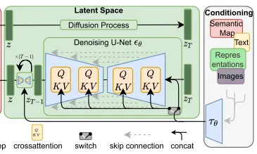
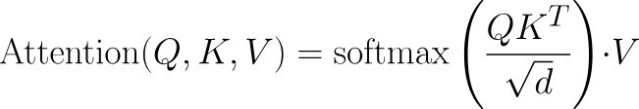
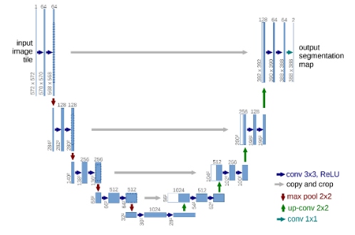
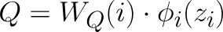
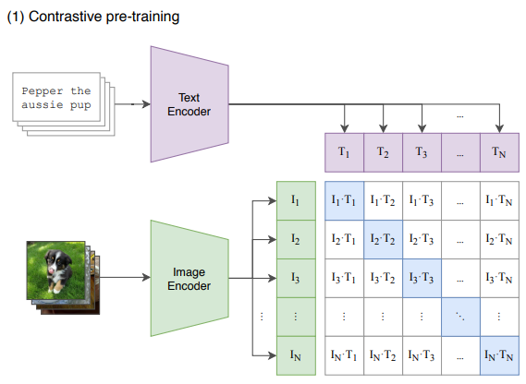
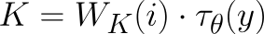
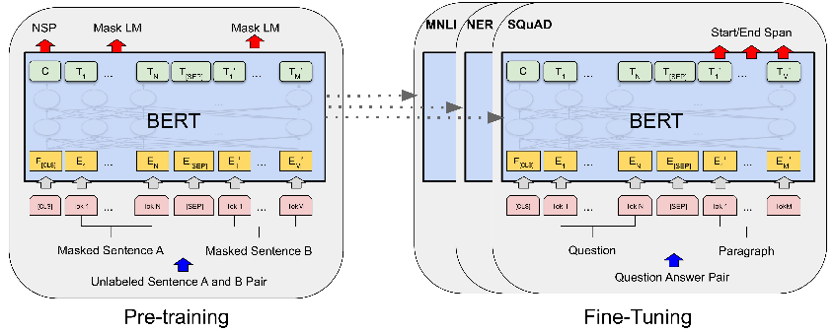
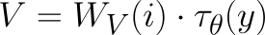
+ Cross-Attention
Adding Cross-Attention Layers
Reflect condition y at various resolutions within the U-Net
Cross-Attention Layer
Loss Func
CLIP Text Encoder
Bert Tokenizer
Notes:
CLIP으로 텍스트 임베딩 생성, BERT tokenizer를 사용하여 텍스트 인코딩.(토큰화)
따라서 CLIP 모델을 사용해서 text를 vector로 변환, 이 벡터를 Cross-Attention으로 U-Net에 조건 부여

Slide 8
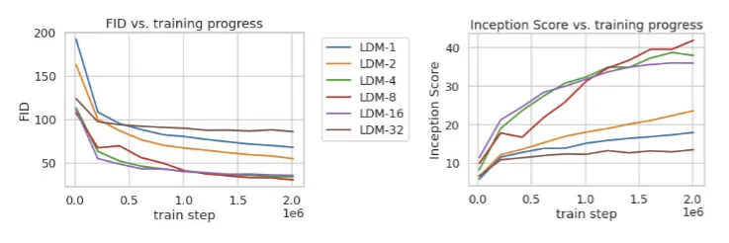
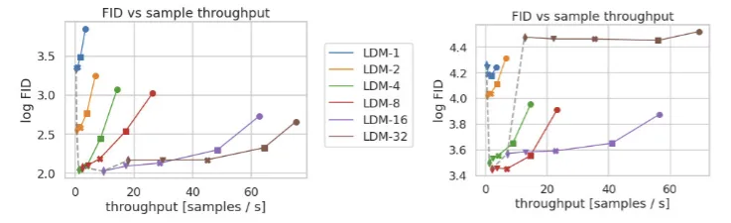
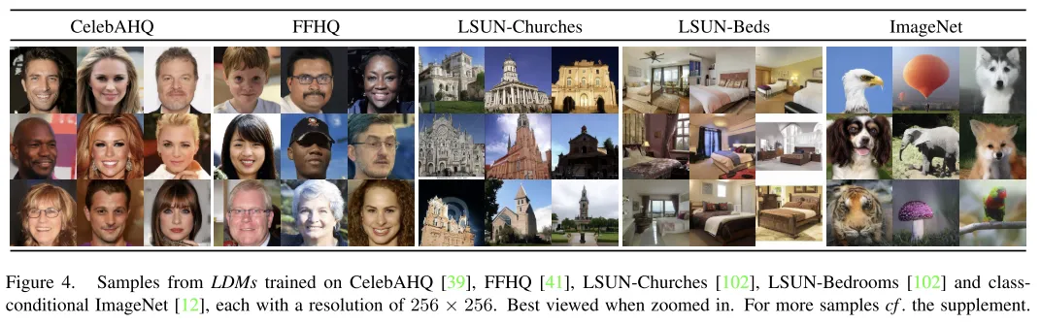
Evaluation
Using Single NVIDIA A100 GPU
f =1 (pixel based)
256x256 images can be generated across various dataset domains
Training Progress and Sample Quality
Sampling Speed and Quality
100 DDIM steps
FID scores : 5000 samples
Dataset : 500k CelebA, 2M ImageNet
Notes:
1.
작은 f 수는 학습 진행이 느림 . LDM 32보다 FID 현저히 낮음
f 가 크면 적은 train step에서 FID가 정체됨
너무 강한 압축은 정보 손실이 심한 것으로 해석됨.
LDM 4 ~ 16 이 대체적으로 좋은 결과
2.
샘플링 속도와 FID 점수를 비교
LDM 4 ~ 8 에서 우수한 성능
pixel based LDM 1과 비교 시 더 낮은 FID 점수이면서 샘플 처리량이 큼
ImageNet은 복잡한 데이터셋이라 낮은 압축률이 필요한 것으로 보임

Slide 9
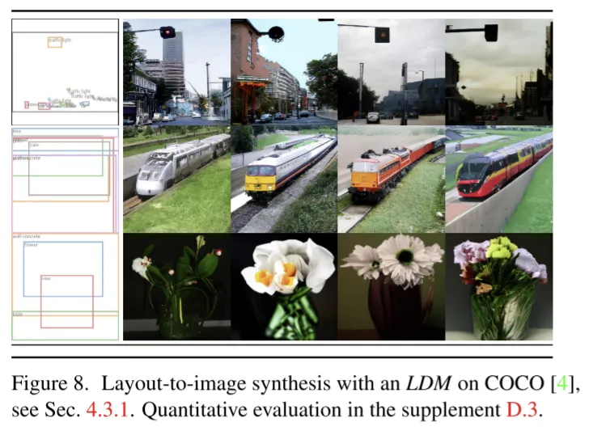
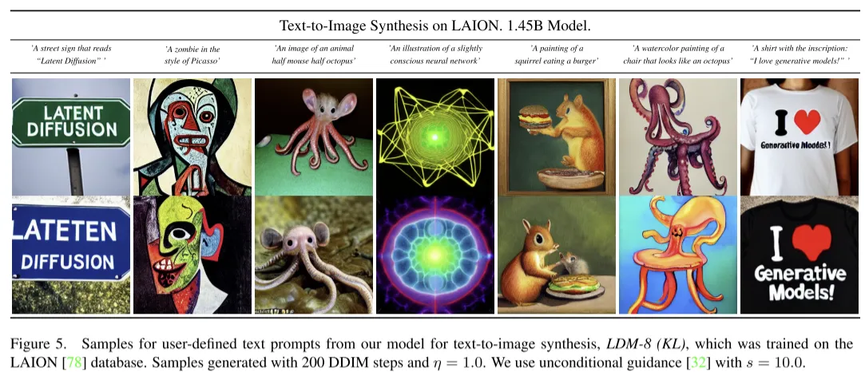
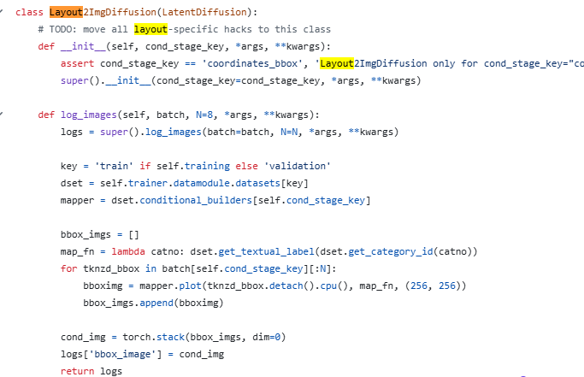
Evaluation
By Using Cross-Attention,
Able to Text-to-Image , Layout-to-Image task
Key : coordinates_bbox

Slide 10
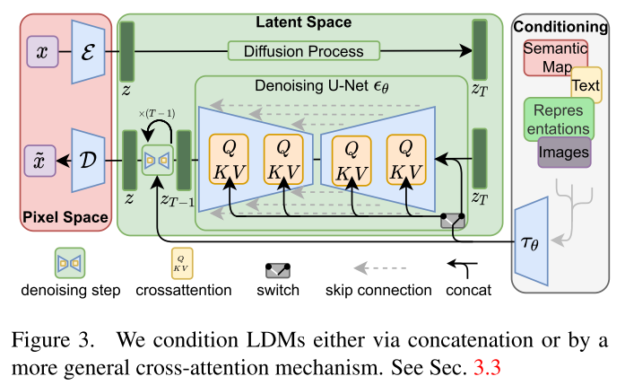
Limitations & Conclusion
Limitations
Slower sampling speed than GAN
Fine representation can cause bottleneck
Deep fake, data bias, ethical considerations
Conclusion
Out of the traditional method of using super resolution models
Use 2D latent space to reduce computation, preserve perceptual information
Diversify tasks with cross-attention

Slide 11
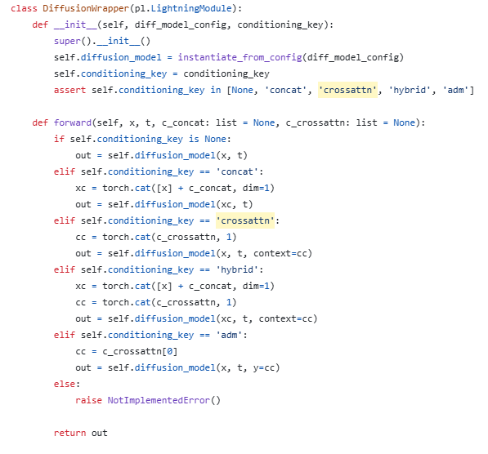
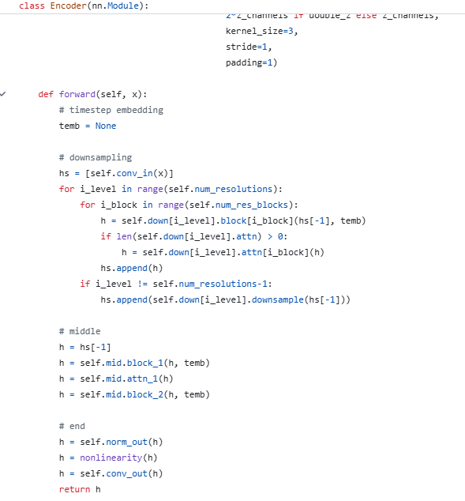
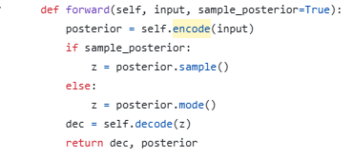
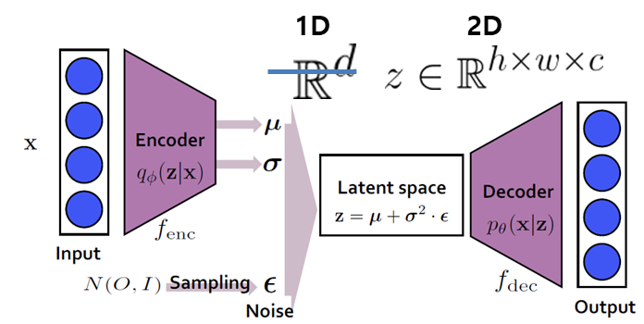
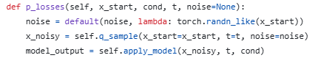
Code
Autoencoder / Cross-Attention
Using Conv, Res_block
latent-diffusion/ldm/models/autoencoder.py
latent-diffusion/ldm/modules/diffusionmodules/model.py
latent-diffusion/ldm/models/diffusion
/ddpm.py

Slide 12
Thank you for your attention.!!!
QnA

